Slide 1
N-tuple networks
Deep Learning and Practice 2018 summer
Department of Computer Science, NCTU
Author: Kuo-Hao Ho
Speaker: Kuo-Hao Ho

Slide 2
About this slides
How n-tuple works
Isomorphic feature pattern
Memory usage

Slide 3


State space problem
N-Tuple Network
We need to distinguish the states for taking the right action
E.g. movie 逃學威龍3 gamble case
Game state space: all possible situation in game
For 2048 case, there are 17¹⁶ (≈10²⁰) board states
17: Empty, 2, 4, …, 65536
16: 4x4 board
Small game space | Large game space
Use tree search | Use value approximator

Slide 4
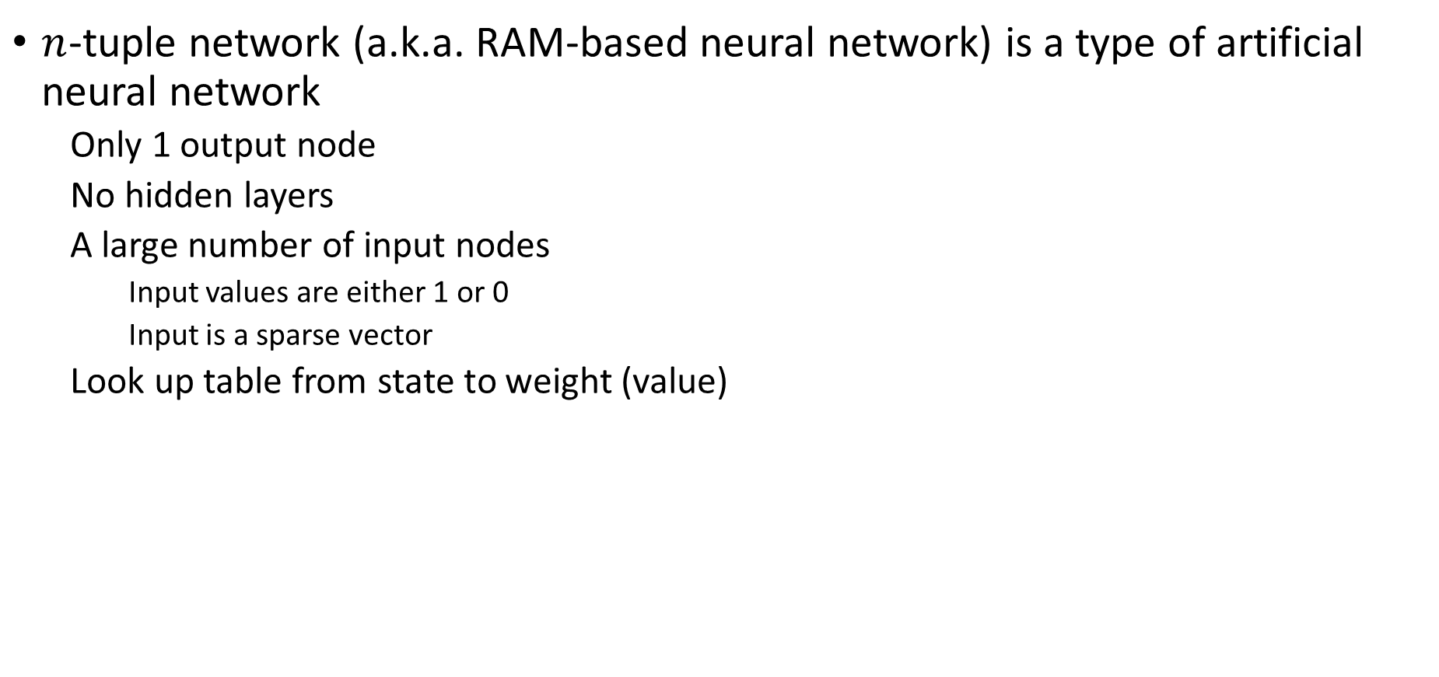
N-Tuple Network
N-Tuple Network
$n$-tuple network (a.k.a. RAM-based neural network) is a type of artificial neural network
Only 1 output node
No hidden layers
A large number of input nodes
Input values are either 1 or 0
Input is a sparse vector
Look up table from state to weight (value)
w₀
w₁
w₂
w₃
w₀
w₁
w₂
w₃
…
…
w_{n-4}
w_{n-4}
w_{n-3}
w_{n-2}
w_{n-1}
w_{n-3}
w_{n-2}
w_{n-1}

Slide 5
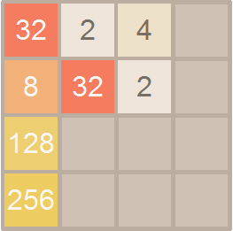
N-Tuple Network
N-Tuple Network
E.g.: one 6-tuple network
One box feature pattern for up-left corner
---Only up-left corner can not present for this board: the others area can be varied
Allocate 2^{4*6} * {type} memory size for keep this look up table
Float: 2^{4*6} * 4 = 64MB
Double: 2^{4*6} * 8 = 128MB
…
…
0
0.34
0
6.48
-3.14
0.25
0
0
0x735051
1
0
0
0
…
…

Slide 6
Isomorphic feature pattern
…
…
0
N-Tuple Network
0.34
0
6.48
-3.14
0.25
0
0
0x735051
1
Feature patterns for present the state
Isomorphic:
Mirror & rotate (8 possible cases)
The action/situation should be similar
0
0
0
…
…

Slide 7
Isomorphic feature pattern
N-Tuple Network
Isomorphic:
Mirror & rotate (8 possible cases)
The action/situation should be similar
The isomorphic feature patterns should present identical state
SUM (Isomorphic feature patterns) = certain state weight

Slide 8
Isomorphic feature pattern
N-Tuple Network
The isomorphic feature patterns should present identical state
Not all feature patterns are always good
E.g.: Line pattern as example
Not covered area

Slide 9
Isomorphic feature pattern
N-Tuple Network
The isomorphic feature patterns should present identical state
Not all feature patterns are always good → N feature patterns
E.g.: Line patterns as example
Feature pattern
Covered area
Not covered area
SUM (Isomorphic feature patterns) = certain state weight

Slide 10
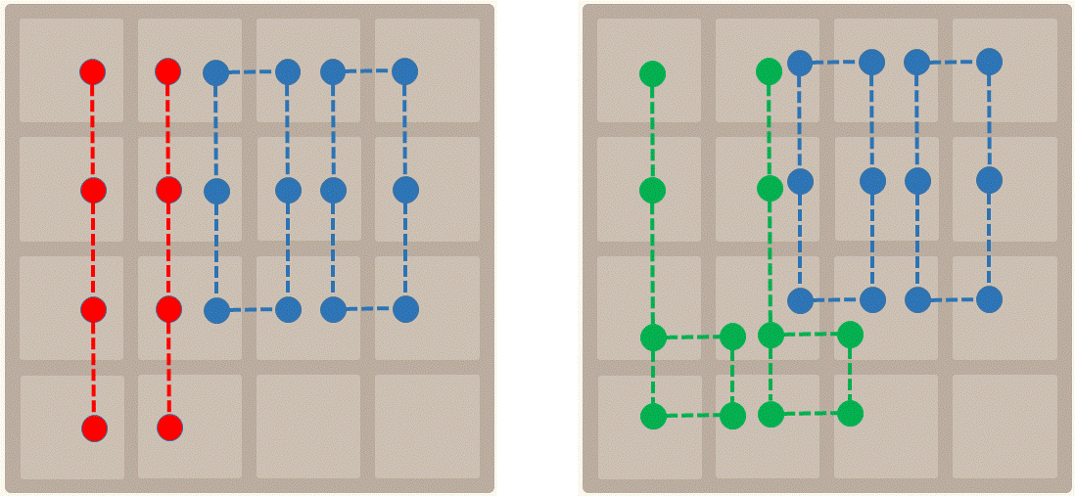
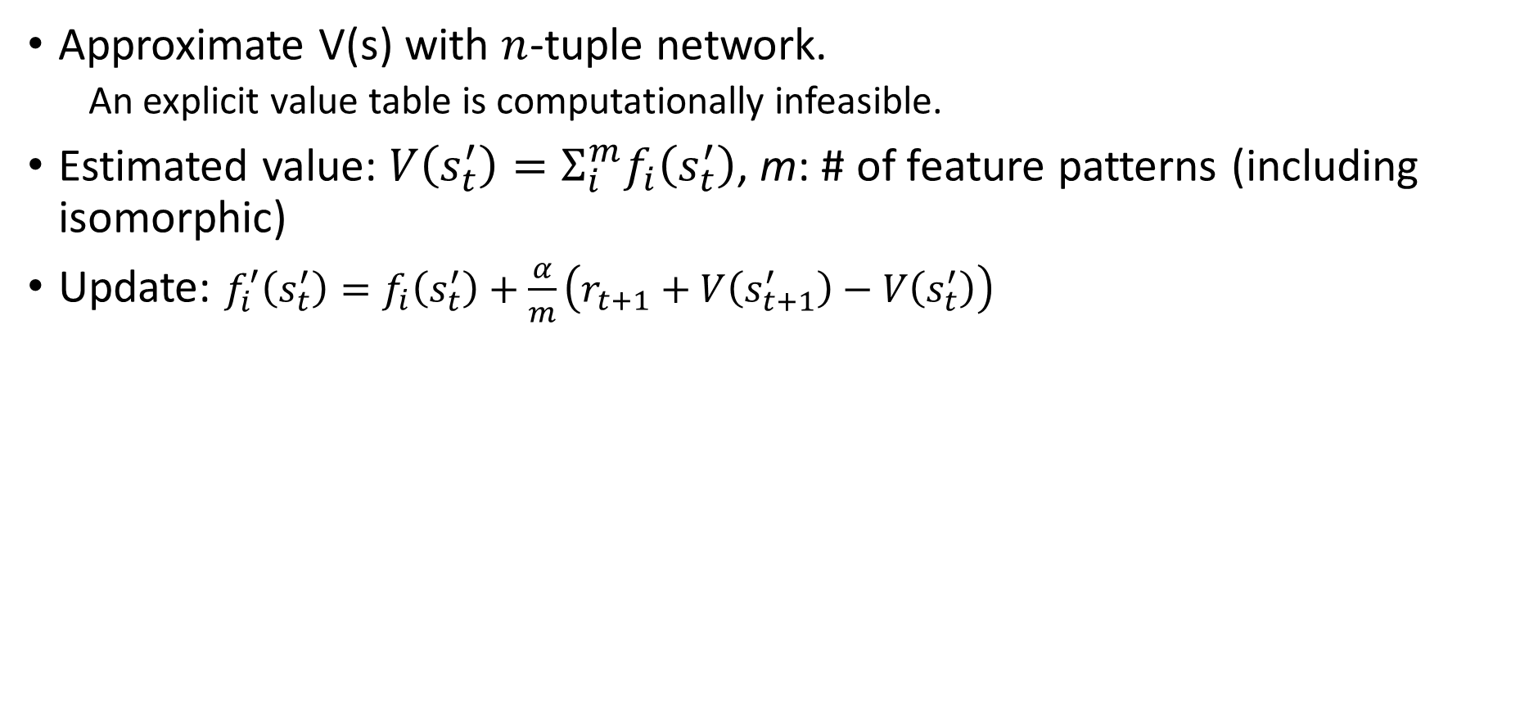
TD-Afterstate & N-Tuple Network
N-Tuple Network
Approximate V(s) with $n$-tuple network.
An explicit value table is computationally infeasible.
Estimated value: $V\left(s_{t}^{′}\right)=Σ_{i}^{m}f_{i}\left(s_{t}^{′}\right)$, m: # of feature patterns (including isomorphic)
Update: $f_{i}^{′}\left(s_{t}^{′}\right)=f_{i}\left(s_{t}^{′}\right)+\frac{α}{m}\left(r_{t+1}+V\left(s_{t+1}^{′}\right)−V\left(s_{t}^{′}\right)\right)$
…
…
0
0.34
0
6.48
-3.14
0.25
0
0
0x735051
1
0
0
4*8 6-tuple networks
0
…
…

Slide 11
TD-Afterstate & N-Tuple Network
N-Tuple Network
Memory usage for 4*6-tupel network = 4 * 2^{4*6} * {type}
Float: 4 * 2^{4*6} * 4 = 256MB
Double: 4 * 2^{4*6} * 8 = 512MB

